Slide 1
Jan 28, 2012
Content Strategy, SEO & Social media
[MM.DD..YY]
[PRESENTER]
Notes:
Whenever I present I always like to get a feel for who is in the room.
How many people here are owners of Drupal website?
How many are builders of Drupal websites?
How many are thinking about getting into Drupal?
How many have done SEO on a Drupal site?
How many people are new to Drupal SEO?
How many people don’t even know what SEO is?

Slide 2
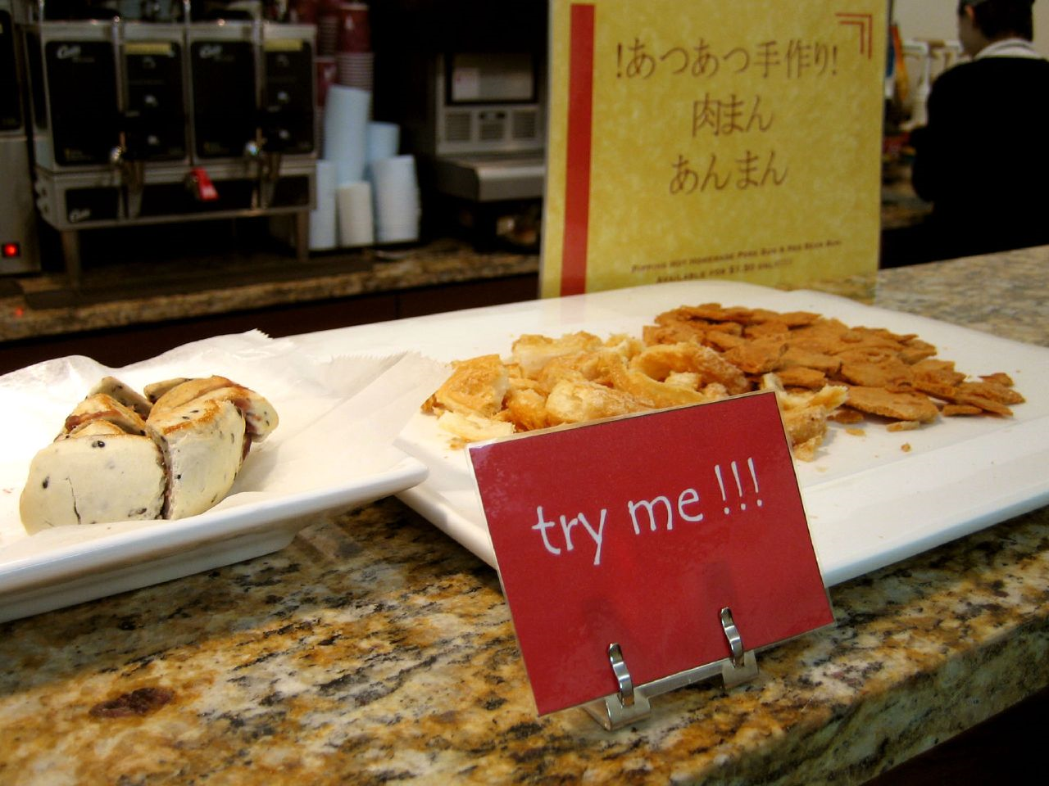
flickr.com/photos/roboppy/64673871
Notes:
Why do brick and mortars do sampling?
How can we use a website to give people samples.

Slide 3
Typical site
online corporate communications
word of mouse
online advertising & PR
performance based ads
(paid search)
content networking
user centered listings
(organic search)
Awareness referrals
offline
communications
website
social media
landing pages
engagement content
social content
traditional advertising & PR
brochureware
Peer recommendations
user engagement
traditional sales
conversion mechanisms
Authority recommendations
customer relationship management
touch pieces
retention programs
user
requests
trusted advisor
requests
Reputation
Management
custom service

Slide 4
Typical site
online corporate communications
word of mouse
online advertising & PR
performance based ads
(paid search)
content networking
user centered listings
(organic search)
Awareness referrals
offline
communications
website
social media
landing pages
engagement content
social content
traditional advertising & PR
brochureware
Peer recommendations
user engagement
traditional sales
conversion mechanisms
Authority recommendations
customer relationship management
touch pieces
retention programs
user
requests
trusted advisor
requests
Reputation
Management
custom service

Slide 5
Advertising doesn’t work
Ads have become noise
Media dilution
Ad circumvention
People don’t trust corporate communications
search engines
Notes:
If you want a successful website, you need to start thinking like a publisher.

Slide 6
Search optimized sites
online corporate communications
word of mouse
online advertising & PR
performance based ads
(paid search)
content networking
user centered listings
(organic search)
Awareness referrals
offline
communications
website
social media
landing pages
engagement content
social content
traditional advertising & PR
brochureware
Peer recommendations
user engagement
traditional sales
conversion mechanisms
Authority recommendations
customer relationship management
touch pieces
retention programs
user
requests
trusted advisor
requests
Reputation
Management
custom service

Slide 7
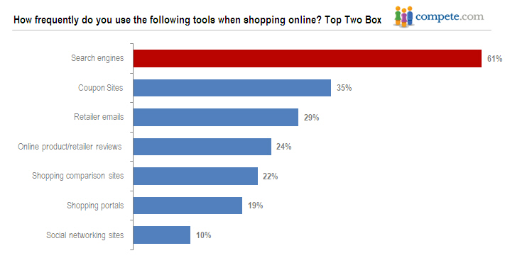
Why search engine marketing works
Its where most people go to look
Specific searches (long tail)
Identified need
All steps of the buying cycle
Google processes over 1 billion searches a day
Notes:
So we need to create content and we need content to connect with our users

Slide 8
Short cuts vs big picture
black hat
vs
white hat
search engine fodder
vs
great content
Short cuts usually works for a while but will likely be caught at some time.
Notes:
Install DAMP, import OE Core

Slide 9
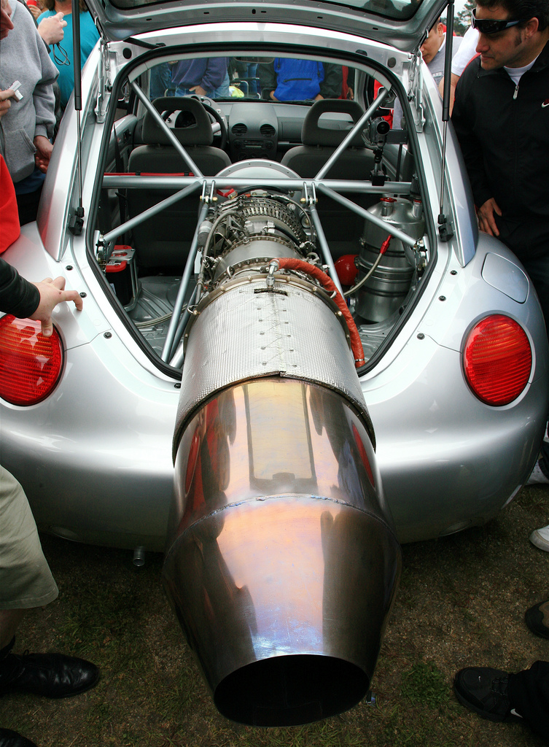
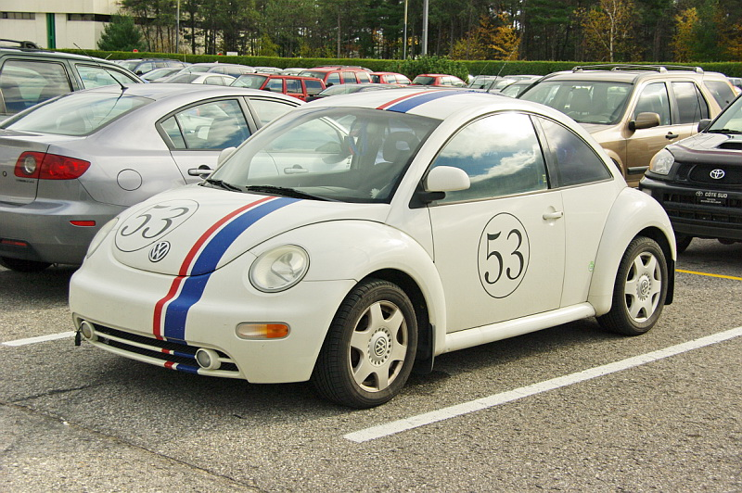
flickr.com/photos/jurvetson
flickr.com/photos/mario_groleau
Notes:
I didn’t have an immediate answer. To build a top website is like building a high performance racecar. It takes do it right took a lot of expertise. You needed solid creative designer, a front end themer, a programmer for the server side work, a marketing expert, usability analyst, project management. It really takes a village to make a great site, and those teams don’t come cheap.
It is highly unlikely that on a tight budget you can find any one or group of people to do it write.
So, then I thought about another option, DIY, do it yourself. A few years earlier this was not particularly feasible, it required a significant mount of technical expertise to code a site. But there were these web applications called content management systems that had come a long ways in a few short years. They do allow non-programmers to build websites. OK so now we could get a solid vehicle for free.
If we could teach people how to trick their vehicle out, now we could be competitive. We could go out and actually win a few.

Slide 10
Engagement
online corporate communications
word of mouse
online advertising & PR
performance based ads
(paid search)
content networking
user centered listings
(organic search)
Awareness referrals
offline
communications
website
social media
landing pages
engagement content
social content
traditional advertising & PR
brochureware
Peer recommendations
user engagement
traditional sales
conversion mechanisms
Authority recommendations
customer relationship management
touch pieces
retention programs
user
requests
trusted advisor
requests
Reputation
Management
custom service

Slide 11
Why social
Most effective way to create awareness (latent need)
Viral
Content & human connections
People trust people
Enables champions
Keep pulse on:
Audience
State of art
Facebook has 800 million users. 50% log on per day.
Notes:
So we need to create content and we need content to connect with our users

Slide 12
Why social + seo
Builds high quality backlinks
Social boosts search
Searchers are researchers
Notes:
So we need to create content and we need content to connect with our users

Slide 13
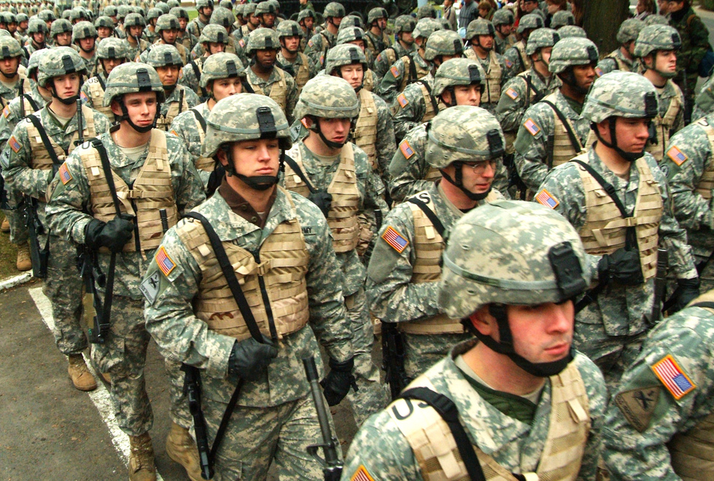
promote
recommended
champions
preferred
loyalty & goodwill
finding
Search engines
awareness
social media
Notes:
Photo: http://www.flickr.com/photos/soldiersmediacenter/397695157

Slide 14
you are a publisher
“
All companies, no matter what the size, must start to think more like publishers than ever before. Consumer behavior has changed drastically over the past few years. Customers are more accepting of content from “non-media” sites and the barriers to publishing are now non-existent.
Joe Pulizzi
Get Content Get Customers
search engines
”
Notes:
If you want a successful website, you need to start thinking like a publisher.

Slide 15
flickr.com/photos/patersor/3036321072/1
Content is king?
Notes:
Content is King.
But not any content, you need to be strategic with your content. You need to engage and attract with your content. That is what we are going to be talking about in this session, I will cover the basics about how to create content, but we will spend most of our time on the attract and engage part.

Slide 16
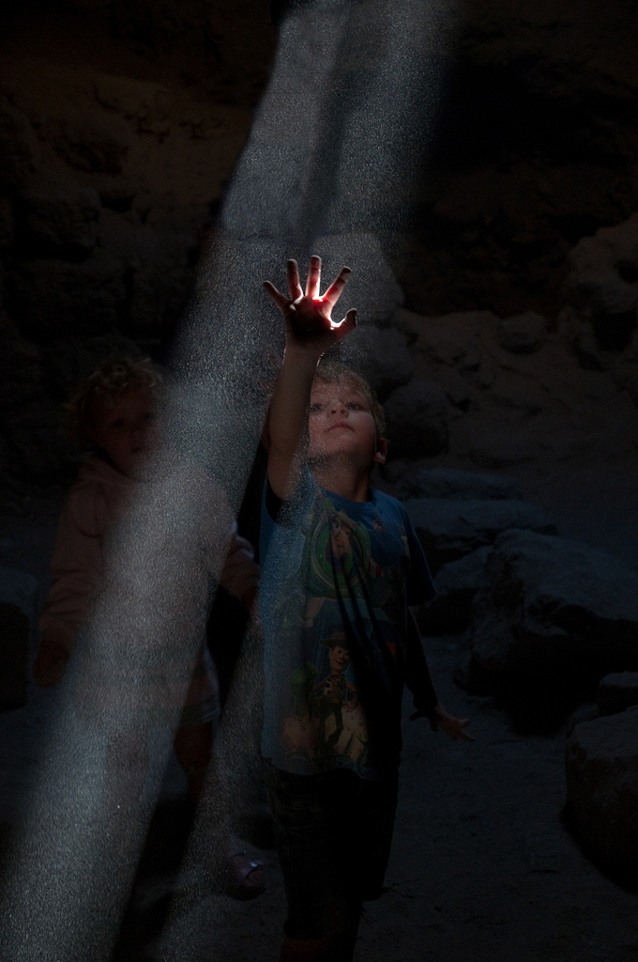
interrupt and repeat
delight and engage
http://www.flickr.com/photos/wwworks/864731205
flickr.com/photos/38659937@N06/5752344624/
Notes:
Number of ads in a day

Slide 17
Why engagement content & social media work
“
Produce great stuff and people will come to you, produce really great stuff and your customers will share and disseminate your message for you.
Ann Handley & CC Chapman
Content Rules: How to Create Killer Blogs, Podcasts, Videos, Ebooks, Webinars (and More) That Engage Customers and Ignite Your Business
”
search engines
Notes:
If you want a successful website, you need to start thinking like a publisher.

Slide 18
process
Planning
Audience
Topics
Create
Promote
Results
Authoring
Publishing
SEO
Social media
Optimizing
Notes:
If you want a successful website, you need to start thinking like a publisher.

Slide 19
Planning: results
increase bike sales
The site should have a clean and professional look
Reduce routine customer call inquires by 50%
Staff should be able to add and edit content
become a recognized leader in the local biking community
Be more viral
Sell more bike repair services
Expand our digital footprint
Show the pictorial history of results bikes
To increase traffic to the site
Sell more bikes online
Get 500 “Likes” on Facebook
The site should be intuitive and easy to navigate
Increase bike rentals by 100%
Double our mailing list
Visitors should be able to find what they want in no more than 3 clicks
Notes:
It powers some of the world’s top websites such as whitehouse.gov, The Economist and Examiner, all of Sony / BMG’s mission websites.

Slide 20
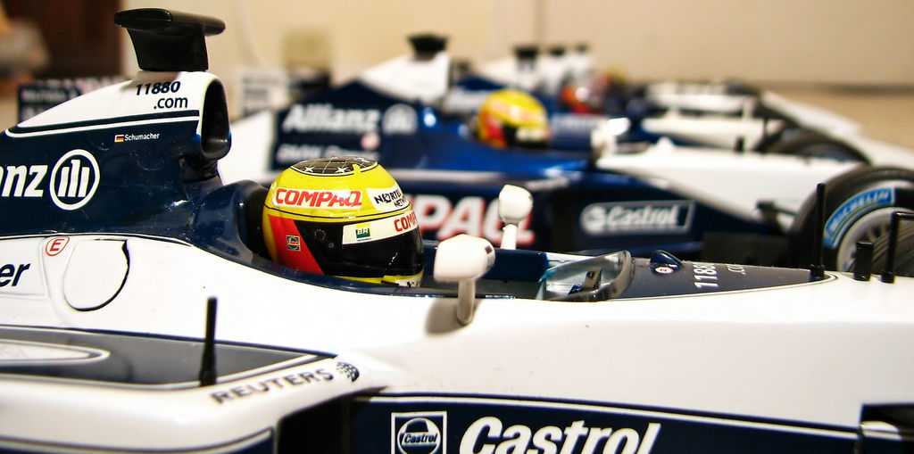
Planning: results
Content should have goals that support the
site goals
flickr.com/photos/pochacco20
Notes:
So we need to create content and we need content to connect with our users

Slide 21
Planning: audience
Primary
Secondary
Tertiary
shoppers
enthusiasts
job seekers
renters
staff
owners
Notes:
It powers some of the world’s top websites such as whitehouse.gov, The Economist and Examiner, all of Sony / BMG’s mission websites.

Slide 22
Planning: audience – get targeted
enthusiasts
shoppers
staff
local newspaper
bike shoppers
staff
sports blogger
new mom/parent
website administrator
fans
person who wants to upgrade their bike
renters
owners
job seekers
tour guide
bike owners
job seekers
people from out of town
casual bikers
new bike rider
hotels that need bikes for guests
competitive rider
Notes:
It powers some of the world’s top websites such as whitehouse.gov, The Economist and Examiner, all of Sony / BMG’s mission websites.

Slide 23
Planning: topics
Audience driven
Conjecture
Ask
Monitor
Customer touch points
Social media
Search
Author/staff driven
Passions
Recent projects
Organization driven
News and events
Success stories
Notes:
So we need to create content and we need content to connect with our users

Slide 24
process
Planning
Audience
Topics
Create
Promote
Results
Authoring
Publishing
SEO
Social media
Optimizing
Notes:
Creation involves three steps, authoring which is writing or recording the content, optimizing for humans and search engines and publishing to the web. The lines between these often blur, particularly in small organizations where one person might handle all the steps. Larger organizations however often have a publishing workflow where subject mater experts handel the authoring, and various editors the optimizing and publishing.

Slide 25
Create: authoring
Blend the art of story telling (literature) with the science of reporting (journalism)
Be human
Share or solve; don’t shill
Delight and surprise
Notes:
So we need to create content and we need content to connect with our users

Slide 26
create: engagement focused inverted pyramid
Most important content first
Great Headlines
“what’s in it for me” test
hook: pique curiosity, intrigue, challenge conventions
power words: secrets, hints, how-to
unique analogies
relate to trending topic
numbered lists
Goal of the headline is to get people to read the first sentence. Goal of first sentence is to get people to read the second. Goal of second is get them to read the rest.
Notes:
So we need to create content and we need content to connect with our users

Slide 27
Create: optimizing
Scanable & Chunkable
right sized
headers
bullets
emphasis, strong, blockquotes, sidebars
Media integration
Photos, videos, audio, presentation slides
Links to read more
Dig deeper
Related
Tag and categorize
Notes:
So we need to create content and we need content to connect with our users

Slide 28
Create: publishing
website
feeds
syndication
APIs
aggregation
your properties
3rd parties
Facebook
news sites
YouTube
LinkedIn
aggregators
related sites
Notes:
So we need to create content and we need content to connect with our users

Slide 29
process
Planning
Audience
Topics
Create
Promote
Results
Authoring
Publishing
SEO
Social media
Optimizing
Notes:
Creation involves three steps, authoring which is writing or recording the content, optimizing for humans and search engines and publishing to the web. The lines between these often blur, particularly in small organizations where one person might handle all the steps. Larger organizations however often have a publishing workflow where subject mater experts handel the authoring, and various editors the optimizing and publishing.

Slide 30
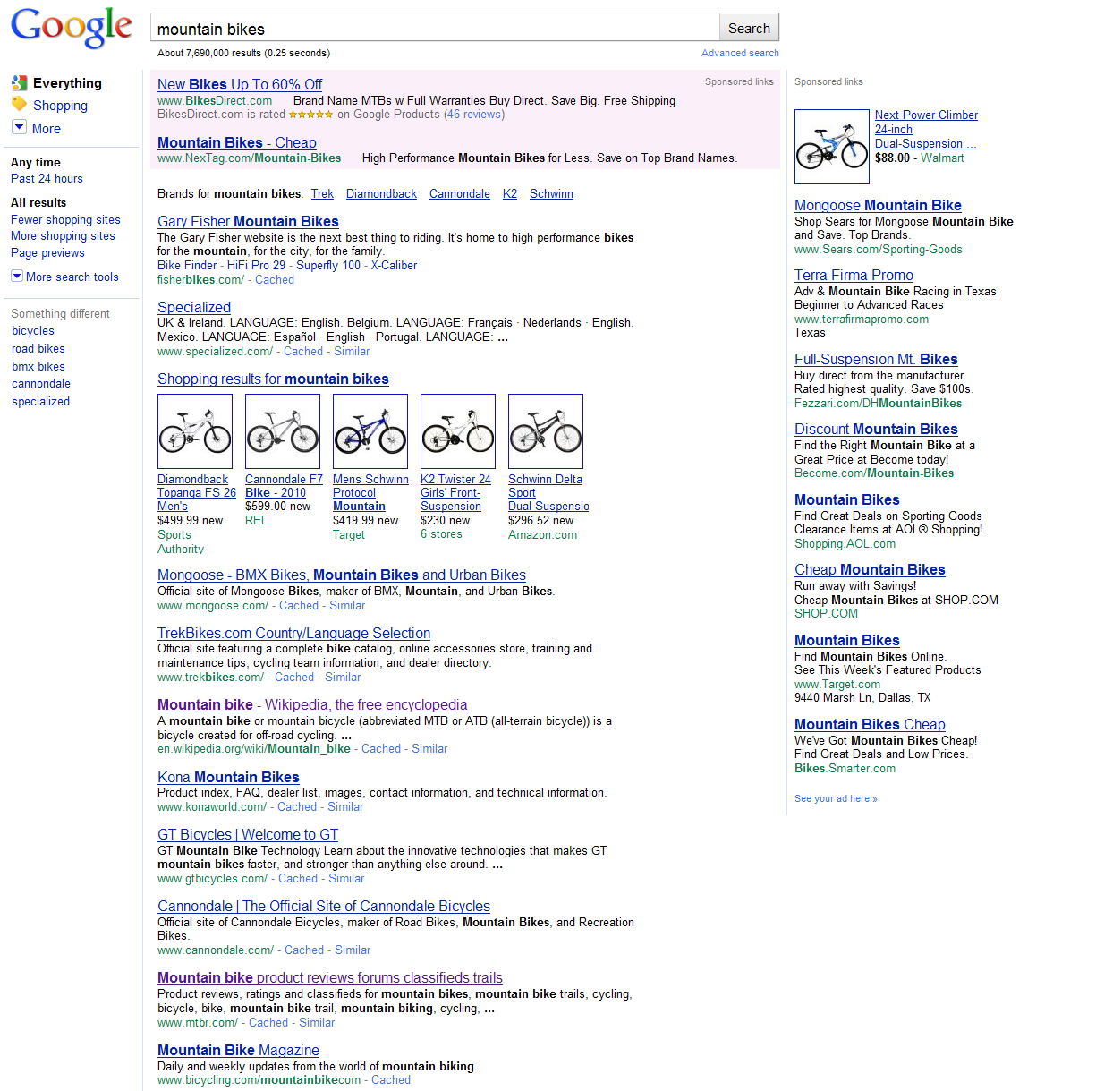
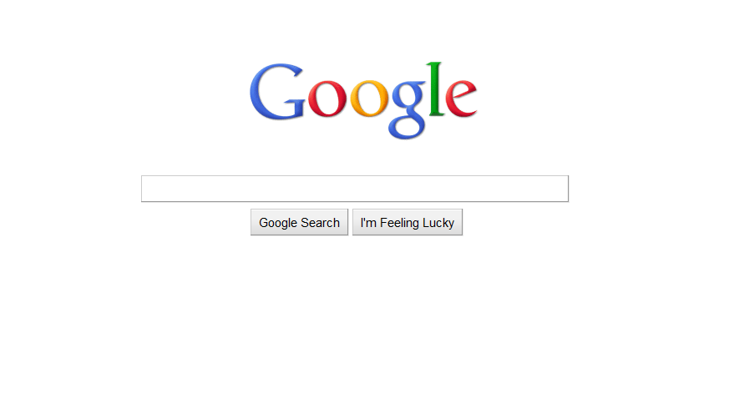
paid
organic
Notes:
What is SEO? What is all the hub bub about? Its all about this box. This magically box that millions of people everyday query every day. The magic box comes back with an answer, actually millions of answers. SEO is about making sure that when people search for what our website is about that we come up not just as any answer, but one of the top answers.

Slide 31
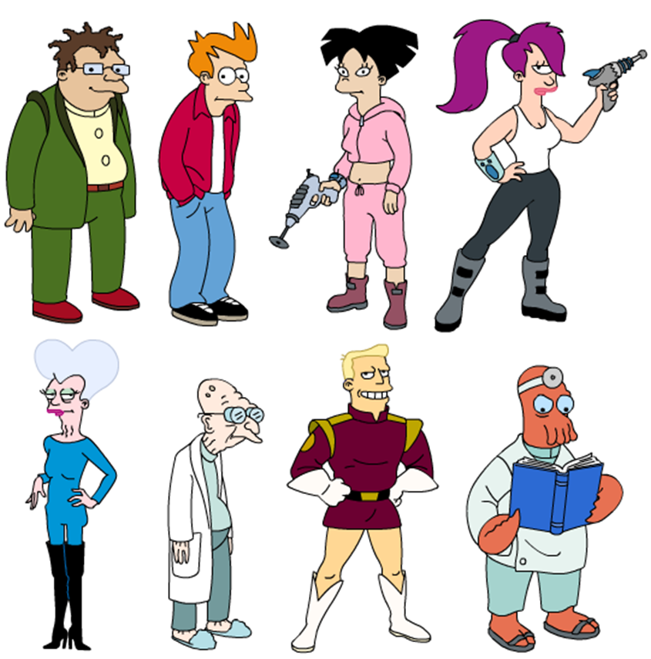
Add a user
search engines
Notes:
Since most people are familare with wr
[photo: http://www.flickr.com/photos/mag3737/2940469019/]

Slide 32
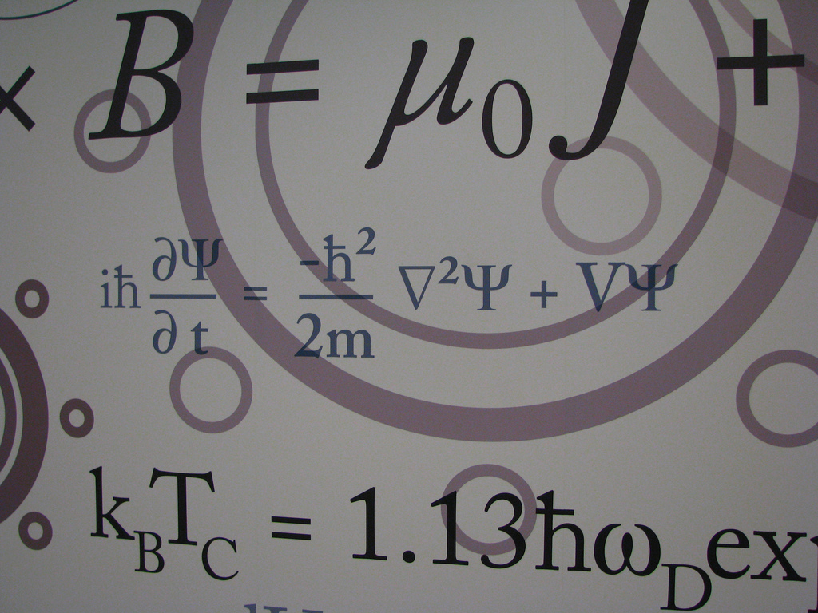
seo magic formula
great architecture
great rankings
great backlinks & buzz
great content
Notes:
[photo: http://www.flickr.com/photos/billburris/2245430380/]

Slide 33
seo architecture easy button
Meta tags
Pathauto
Global redirect
Redirect
XML Sitemap
SEO Essentials
Notes:
[photo: http://www.flickr.com/photos/missnita/509719978/]

Slide 34
content workflow
topic driven
keyword driven
organization
relevance
author
popularity
user
competition
keyword
research
keyword
research
topics
content
authoring
content
authoring
keywords
content
optimization
content
optimization
promotion

Slide 35
site keyword research
expanded keyword list
spreadsheet
brainstorm keywords phrases
Drupal
spreadsheet
research
lateral phrases
search volume
competitiveness
evaluate relevancy
targeted keyword list
3rd party tools
spreadsheet
seed keyword list
E-mail
E-mail

Slide 36
keyword research module
[insert screencast of site keyword research]
Notes:
[photo: http://www.flickr.com/photos/mag3737/2940469019/]

Slide 37
page keyword research
content keyword list
determine main keywords from content
research
lateral phrases
search volume
competitiveness
targeted keyword + modifiers

Slide 38
keyword research module
[insert screencast of page keyword research]
Notes:
[photo: http://www.flickr.com/photos/mag3737/2940469019/]

Slide 39
content optimization
page title
40 – 70 characters
use target keyword phrase at least one time
body
200 – 800 words
include target keyword phrase 2 – 4 times
keyword phrase prominence > 50%
meta description
< 160 characters
meta keywords
1 – 15 phrases

Slide 40
content analysis module
[insert screencast of content optimizer]
Notes:
[photo: http://www.flickr.com/photos/mag3737/2940469019/]

Slide 41
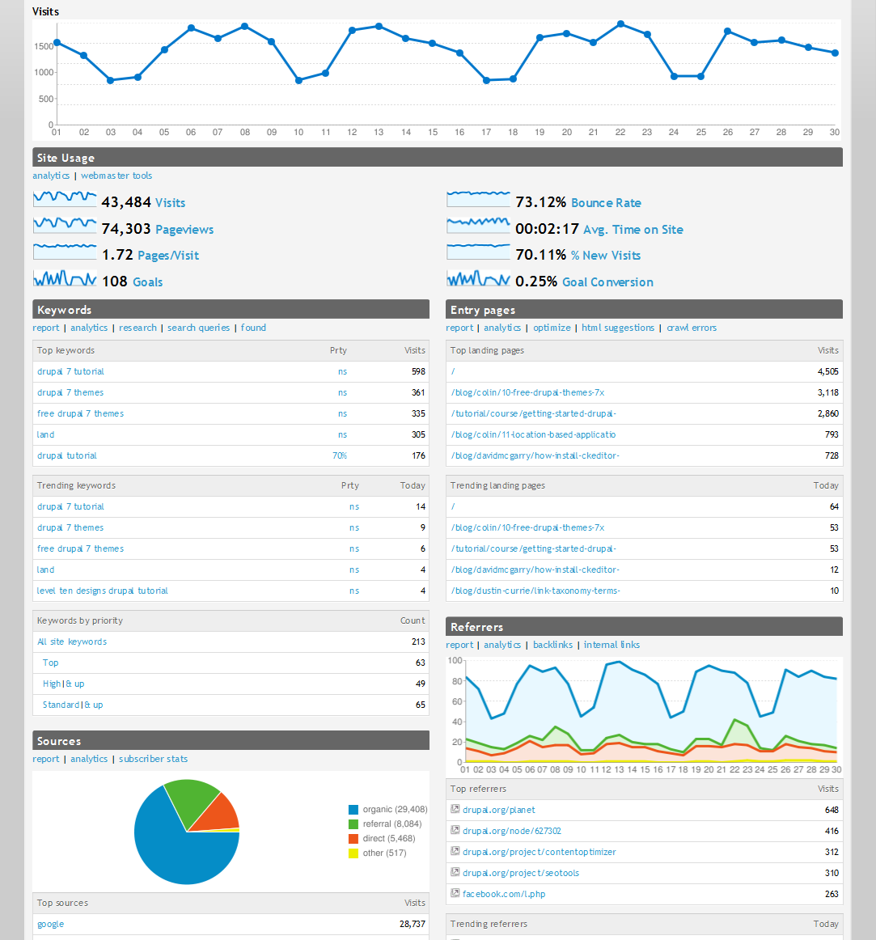
all-in-one optimization kit
SEO Tools
Notes:
[photo: http://www.flickr.com/photos/missnita/509719978/]

Slide 42
social media: profiles
Twitter
YouTube
Facebook
Flickr
Google+
SlideShare
LinkedIn

Slide 43
social media: sharing
Twitter
StumbleUpon
Facebook
Del.icio.us
Google+
SlideShare
LinkedIn
Digg

Slide 44
keyword clustering

Slide 45
DEMO
flickr.com/photos/zigazou76/3622235298

Slide 46
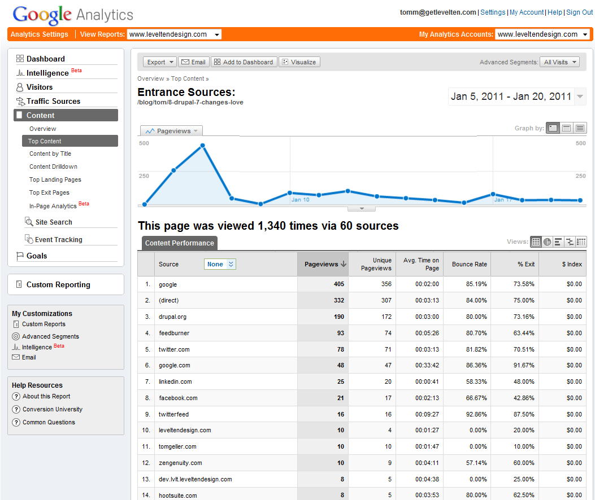

Slide 47
all-in-one results oriented website
A results oriented website in a box*
*box not included
For organizations age 0 to 150
Super secret D7 version:
http://apps.leveltendesign.com
Notes:
[photo: http://www.flickr.com/photos/missnita/509719978/]

Slide 48
thank you!
Tom McCracken
LevelTen Interactive
Director
Phone: 214.887.8586
Email: tom@leveltendesign.com
Twitter: @levelten_tom
Blog: leveltendesign.com/blog/tom
LinkedIn: linkedin.com/in/tommccracken

